Slide 1

Sample Questions
&
Suggested Answers
SSC Examination
English Paper One
Subject Code: 107
Full Marks : 100
Time : 3 hours

Slide 2
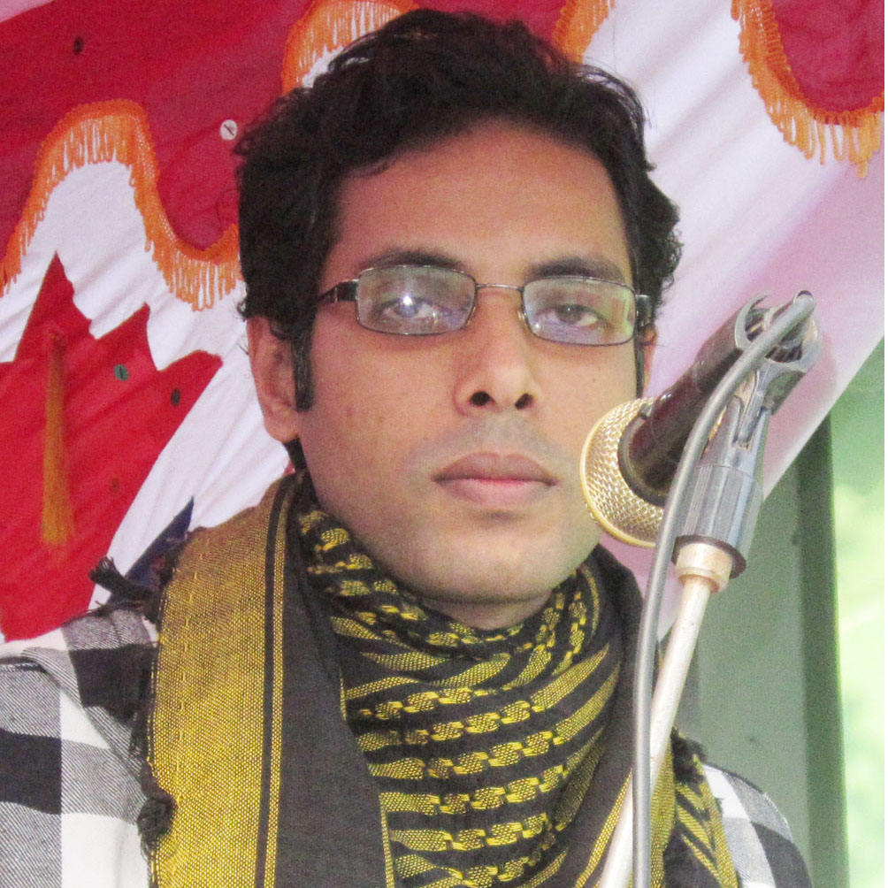

MY PROFILE
Biddut Khoshnobish
Assistant Teacher
Sristy Residential School Tangail
Cell: 018 3311 6567
E-mail: biddut.khoshnobish@gmail.com

Slide 3

Subject
English For Today
Class IX-X

Slide 4
Passage: 1
Question No: 1-3

Slide 5
1. Choose the correct answer from the alternatives. 1x 7 = 7
A. Which of the following has the closest meaning of the word ‘enforce’ used in line 2? a) support b) impose c) strengthen d) highlight
B. What does the expression ‘they text in class’ in line 5 mean? a) They read a text in class given by the teacher. b) They send short messages in class using cell phones. c) They take at least one of their textbooks in class. d) They copy a passage from their textbook in class.
C. Which of the following best describes the similarity between Monica’s mother and Monica’s father? a) Mother and father both like technology. b) Mother and father both dislike video games. c) Mother and father both think the internet is dangerous. d) Mother and father both care about Monica’s future.
D. Which of the following word describes Monica’s mother best? a) careful b) ridiculous c) cruel d) rude

Slide 6
Suggested Answer

Slide 7
      Ans. to the Q. No– 1
      A. (b)
      B. (b)
      C. (d)
      D. (a)
      E (a)
      F. (c )
      G. (b)
      Answer to the Question No– 1
BEST

Slide 8
  2. Answer the following questions. 2 x 5 =10
  From your reading of paragraph 1 of the passage, give an example of inappropriate use of cell phones by school students.
  b) “It’s like having a gun in the house.” Who says this? Why does s/he say this? Explain in 2/3 sentences.
  c) What does Monica’s father think about video games?
  d) Describe the differences between Monica’s mother and Monica’s father in 2/3 sentences.
  e) Do you support the attitude that Monica’s mother has toward technology? Why/Why not? Explain in 2/3 sentences.

Slide 9
Suggested Answer

Slide 10
Ans. to the Q. No– 2
a) It is said in paragraph 1 that 43 percent of the students who bring their cell phones to schools without permission send text messages at least once a day. This is an alarming example of inappropriate use of cell phones by students at schools.
b) This is said by Monica’s mother. She says this to highlight the potential dangers of the internet. Having a gun in the house is always risky and one may not always use a gun in a controlled way. According to Monica’s mother, having the internet in the house can be very harmful for Monica as it is difficult to control.
c) Monica’s father thinks that video games are enjoyable when played for a reasonable amount of time. He believes that one must not play video games for unlimited hours and without self control.
d) Cell phones, video games and the Internet are all examples of technology. Monica’s mother doesn’t want Monica using these devices of technologies because she is worried that they are dangerous or bad for Monica. On the other hand, Monica’s father thinks that Monica should use the technology because it is useful and fun.
e) I don’t support Monica’s mother’s concern about using technologies such as the internet, cell phones and video games. Technology itself is not dangerous or bad. We are living in the age of technology and it can be very useful too. However, I think the young children should be taught about using technology responsibly before they are allowed to use it.

Slide 11
3. Write a summary of the passage in no more than 90 to 100 words. 10

Slide 12
Suggested Answer

Slide 13
Ans. to the Q. No– 3
The issue of using cell phones at school is a matter of recent debate. Many schools are struggling to prevent their students from using cell phones. Guardians also have different views on allowing children to use technological devices such as cell phones, video games and the internet. Monica’s mother is a guardian with a conservative attitude to technology. She does not want her daughter to use technology as it might cause harm to her. On the other hand, Monica’s father has a much liberal attitude to technology. He does not want to deprive Monica of the blessings of technology.

Slide 14
Passage: 2
Question No: 4 & 5

Slide 15
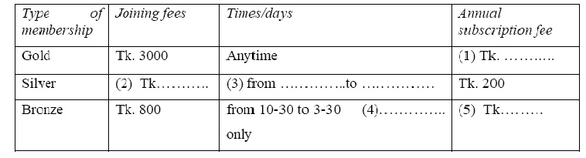
  4. Read the passage on the membership of a sports club. Complete the table below with information from the passage. 1 x 5 = 5

Slide 16
Suggested Answer

Slide 17
Ans. to the Q. No– 4
500/five hundred/5 hundred
2500/ two thousand five hundred
3) 10-00, 4-30/10am, 4-30pm
(both required for correct answer)
4) weekdays
5) 50/fifty

Slide 18
  5. From your reading of the above passage fill in the blanks with suitable words. Use one word only in each blank. 1x5 = 5
  There are three kinds of memberships offered by the Young Bengal Sports Club. The Gold membership is the most expensive but it offers all the (a) ………………. to the members for unrestricted time. Gold members do not have to (b) ……………. any extra amount for attending classes. Silver members pay an annual subscription fee which is 300 taka (c) ………….. than the Gold rate. However, a silver member can’t use the sports club any time he or she wishes. Similarly, a Bronze member has limited (d) …………… to the sports club, from 10-30 am to 3-30 pm on weekdays only. Someone with a small budget can go for the Bronze membership as it is the (e) …………….. of all the schemes.

Slide 19
Suggested Answer

Slide 20
Ans. to the Q. No– 5
facilities/ amenities/ services
pay/ give/ deposit
less/ lower/ cheaper
access/ entry/ admission
cheapest

Slide 21
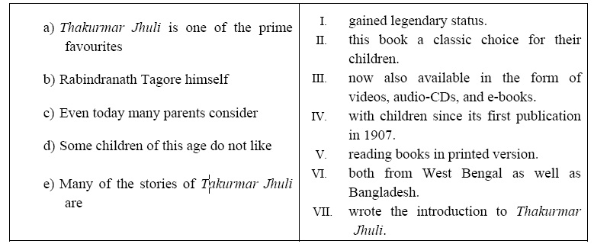
  6. Match the parts of sentences given in column ‘A’ and column ‘B’ to write five complete sentences. There are more parts of sentences in column ‘B’ than required. 1x 5 =5

Slide 22
Suggested Answer

Slide 23
Ans. to the Q. No– 6
Thakurmar Jhuli is one of the prime favourites with children since its first publication in 1907. Rabindranath Tagore himself wrote the introduction of Thakurmar Jhuli. Even today many parents consider this book a classic choice for
their children. Some children of this age do not like reading books in printed version. Many of the stories of Takurmar Jhuli are now also available in the form of videos, audio-CDs, and e-books.

Slide 24
7. Put the following parts of the story in correct order to rewrite the whole story. 1x 8 = 8
a) When he arrived at the farm he saw a farmer standing outside surrounded by many three legged chickens.
b) The farmer replied, "Yes, I breed them because my wife and my son live here and we all like to eat chicken legs. Since a chicken only has two legs, I breed this three legged ones so we could all eat our favorite piece."
c) The man decided to drive faster to see if the chicken could follow the speed. As he went faster and faster, so did the chicken.
d) One day, a man was driving in the countryside when he saw a three legged chicken running down the road next to his car.
e) "Are these your chickens?" the man asked.
f) "I don’t know. I haven't caught one yet!"
g) Suddenly the chicken stopped running next to the car and ran down a country road towards a farm. The man decided to follow the chicken to the farm.
h) "That's amazing!" said the driver "How do they taste?"

Slide 25
Suggested Answer

Slide 26
Ans. to the Q. No– 7
Ans. to the Q. No– 7
The parts of stories can appear in the following order:
d), c), g), a), e), b), h) and f)
1 | 2 | 3 | 4 | 5 | 6 | 7 | 8
d | c | g | a | e | b | h | f
OR

Slide 27
  8. Answer the following questions to write a paragraph on Your Most Favourite Song. You should write about 250 words. 10
  a) What is your favourite song?
  b) Who is the writer of the song lyrics?
  c) What kind of song is it?
  d) What is said in the song?
  e) Why do you like this song?

Slide 28
Suggested Answer

Slide 29
Ans. to the Q. No– 8
My Most Favourite Song
There are many songs that appeal to my mind. In fact, the list of my favourite songs is rather long. But if I am asked to choose my most favourite song, I have to mention just one that comes to my mind instantly. The song is known as ‘Dhana dhanyo pushpo bhora.” This song is written and composed by the great poet and lyricist Dwijendralal Roy, popularly known as D.L. Roy. This is a song of patriotism which reflects the glory of our motherland. This is one of the most beautiful patriotic songs I have ever heard. It is said in the song that our mother land is the queen of all the lands on this earth and it is made of dreams and enfolded with memories. The song is a tribute to the matchless natural richness of our motherland. Throughout the song we have vivid descriptions of the wonderful natural blessings, love and affection that we enjoy in this land. The song ends with the yarning that this land that nurtured us from our birth will be the place of our final breath on earth. A sense of pride fills me when I listen to this composition. I salute my motherland as I listen to this song. It depicts our love and respect for our own country and nation. There is one more reason why this song is so close to my heart. I grew up listening to this song. Every time I listen to this song, I go back to my mother’s lap and hear her melodious voice singing “Sokol desher rani she je amar jonmobhmi”. (268 words)
My Most Favourite Song

Slide 30
Ans. to the Q. No– 8
My Most Favourite Song
There are many songs that appeal to my mind. In fact, the list of my favourite songs is rather long. But if I am asked to choose my most favourite song, I have to mention just one that comes to my mind instantly. The song is known as ‘Dhana dhanyo pushpo bhora.” This song is written and composed by the great poet and lyricist Dwijendralal Roy, popularly known as D.L. Roy. This is a song of patriotism which reflects the glory of our motherland. This is one of the most beautiful patriotic songs I have ever heard. It is said in the song that our mother land is the queen of all the lands on this earth and it is made of dreams and enfolded with memories. The song is a tribute to the matchless natural richness of our motherland. Throughout the song we have vivid descriptions of the wonderful natural blessings, love and affection that we enjoy in this land. The song ends with the yarning that this land that nurtured us from our birth will be the place of our final breath on earth. A sense of pride fills me when I listen to this composition. I salute my motherland as I listen to this song. It depicts our love and respect for our own country and nation. There is one more reason why this song is so close to my heart. I grew up listening to this song. Every time I listen to this song, I go back to my mother’s lap and hear her melodious voice singing “Sokol desher rani she je amar jonmobhmi”. (268 words)

Slide 31
Ans. to the Q. No– 8
My Most Favourite Song
There are many songs that appeal to my mind. In fact, the list of my favourite songs is rather long. But if I am asked to choose my most favourite song, I have to mention just one that comes to my mind instantly. The song is known as ‘Dhana dhanyo pushpo bhora.” This song is written and composed by the great poet and lyricist Dwijendralal Roy, popularly known as D.L. Roy. This is a song of patriotism which reflects the glory of our motherland. This is one of the most beautiful patriotic songs I have ever heard. It is said in the song that our mother land is the queen of all the lands on this earth and it is made of dreams and enfolded with memories.
The song is a tribute to the matchless natural richness of our motherland. Throughout the song we have vivid descriptions of the wonderful natural blessings, love and affection that we enjoy in this land. The song ends with the yarning that this land that nurtured us from our birth will be the place of our final breath on earth. A sense of pride fills me when I listen to this composition. I salute my motherland as I listen to this song. It depicts our love and respect for our own country and nation. There is one more reason why this song is so close to my heart. I grew up listening to this song. Every time I listen to this song, I go back to my mother’s lap and hear her melodious voice singing “Sokol desher rani she je amar jonmobhmi”. (268 words)

Slide 32
Sentence case: A visit to a historical place
UPPER CASE: A VISITE TO A HISTORICAL PLACE
lower case: a visit to a historical place
Title Case: A Visit to a Historical Place

Slide 33
What is Title Case?
The first letters of all principal words are capitalized.
Except-
Articles (a, an, the)
Coordinating conjunctions (and, but, or, nor, for, so…)
Prepositions (in, of, for, at, on, to…)

Slide 34
  9. Read the beginning of a story. Write ten new sentences to complete the story. 1x 10 = 10
  A slave named Androcles once escaped from his master and fled to the forest. As he was wandering about there he came upon a Lion lying down moaning and groaning. At first he turned to flee, but finding that the Lion did not pursue him, he turned back and went up to him. As he came near, the Lion put out his paw, which was all swollen and bleeding, and Androcles found that a huge thorn had got into it, and was causing all the pain. ……….

Slide 35
Suggested Answer

Slide 36
Ans. to the Q. No– 9
Androcles
A slave named Androcles once escaped from his master and fled to the forest. As he was wandering about there he came upon a Lion lying down moaning and groaning. At first he turned to flee, but finding that the Lion did not pursue him, he turned back and went up to him. As he came near, the Lion put out his paw, which was all swollen and bleeding, and Androcles found that a huge thorn had got into it, and was causing all the pain. He pulled out the thorn and bound up the paw of the Lion, who was soon able to rise and lick the hand of Androcles like a dog.
Then the Lion took Androcles to his cave, and every day used to bring him meat from which to live. But shortly afterwards both Androcles and the Lion were captured, and the slave was sentenced to be thrown to the Lion, after the latter had been kept without food for several days. The Emperor and all his Court came to see the spectacle, and Androcles was led out into the middle of the arena. Soon the Lion was let loose from his den, and rushed bounding and roaring towards his victim. But as soon as he came near to Androcles he recognised his friend, and fawned upon him, and licked his hands like a friendly dog. The Emperor, surprised at this, summoned Androcles to him, who told him the whole story. Whereupon the slave was pardoned and freed, and the Lion let loose to his native forest.
Gratitude is the sign of noble souls.

Slide 37
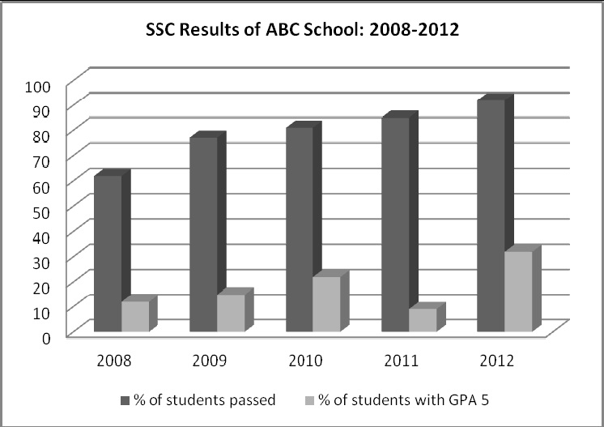
  10. The graph below shows the results of SSC exam of ABC Secondary School from 2008 to 2012. Describe the chart in 150 words. You should highlight and summarise the information given in the chart. 10

Slide 38
Suggested Answer

Slide 39
Ans. to the Q. No– 10
The graph shows the results of SSC examinations of ABC Secondary School from 2008 to 2012. In general, the graph shows a gradual improvement of the SSC candidate’s performance within this time. It is seen from the graph that the pass rate increased from 60% in 2008 to 92 % in 2012.
The graph also shows an increase of candidates who passed with a GPA 5 except in 2011. In fact, the school had the lowest rate of GPA 5 holders in 2011, which was only 9%. The performances of the SSC candidates were almost similar in 2009 and 2010, with slightly better results in 2010. The school recorded the best results in 2012 when the pass rate went beyond the 90% mark. Moreover, a record of 32% candidates passed with a GPA 5 in this year.
Overall, the graph illustrates that the SSC results of ABC Secondary School is improving steadily. (152 words)

Slide 40
  11. Suppose, you have a friend in Nepal named Mahesh/Renuka. You have just visited Nepal and had a great time with Mahesh/Renuka at his/her place in Kathmandu. Write an email to Mahesh /Renuka thanking him/her for the hospitality he/she offered you in Kathmandu. 10

Slide 41
Suggested Answer
[NB: In this letter UK style of formatting is followed. Students are free to follow any style/format to write their letters.
However, a mixture of more than one style in the same letter is not desirable.]

Slide 42
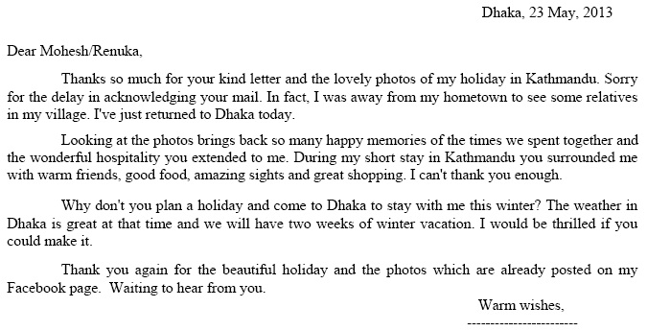
Ans. to the Q. No– 11
Correct

Slide 43
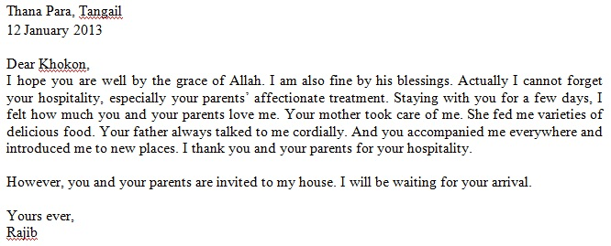
Ans. to the Q. No– 11
Correct

Slide 44
To:
Subject:
Date:
kamran007@gmail.com
Exam preparation
25 October 2013
Email
Dear Kamran,
……………………………………………………………………………………………………………………………………………………………………………………………………………………………………………………………………………………………………………………………………………………………………………………………………………………………………………………………………………………………………………………………………………………………………………………………………………………………………………………………………………………………………………………………………………………………
………………………………………………………………………………………………………………………………………………………………………………………………………………………………………………………………………………………………………………..
Yours ever,
Rana

Slide 45
  12. Alisha is a 17 year old girl. She has been suffering from fever for three days. She has a temperature and a cough and she feels pains all over her body. She doesn’t have an appetite and can’t take anything except fruit juice. Alisha goes to the doctor. The doctor asks Alisha questions to know about her illness. Hearing everything, the doctor doesn’t prescribe any medicine but suggests Alisha to take rest for one week and have enough fluid. Write a short dialogue that Alisha might have with the doctor. 10

Slide 46
Suggested Answer

Slide 47
Ans. to the Q. No– 12
A dialogue between Alisha and a doctor.
Doctor : Hello, What seems to be your problem?
Alisha : I have a temperature and a very bad cough.
Doctor : How long has this cough been bothering you?
Alisha : I think, for last 3 days…
Doctor : Right. Do you have any other problems at this moment?
Alisha : I have terrible ache all over my body.
Doctor : Do you have any history of back pain?
Alisha : No, this is the first time.
Doctor : Ummm…. So, what are you having in your meals now?
Alisha : In fact, I can’t eat anything now. I don’t have any appetite. I had some fresh juice and one or two biscuits this morning, and a cup of lemon tea….that’s it.
Doctor : Listen, you have had a bad flu. In fact, many people are having flu these days.
Alisha : Are you going to give me any medicine?
Doctor : No. I don’t think you need medicines at this stage. All you need is complete rest. And try drinking enough fluids….like orange juice. You can also drink hot coffee or soup.
Alisha : But how long do I need to be at home? My school exam is due next month.
Doctor : Don’t worry. You can join your classes, hopefully from next week.
Alisha : Thank you doctor for being so nice with me.
Doctor : You are welcome. (233 words)

Slide 48


